Slide 1


Slide 2
OpenXData
Solution Type:
Mobile Data, GPS enabled, Offline capabilities, Photo / Video capable, Monitoring & Evaluation
Sectors:
Health, Agriculture, Education, Environment, Water & Sanitation
Platform:
Android, Web
Hardware:
Basic phone, Feature phone, Smart phone, Tablet, PC (Laptop)
Pricing:
Open Source (free)

Slide 3
OpenXData
It is a data collection tool that enables definition of forms through a user-friendly graphical interface.
Allows administration of users and authenticated form uploads.
Functionality to download data on low-end mobile phones or web-based form entry.
Offline data collection when mobile phone is out of signal.
Upload of forms via SMS, GPRS, or Bluetooth automatic data export to relational database

Slide 4
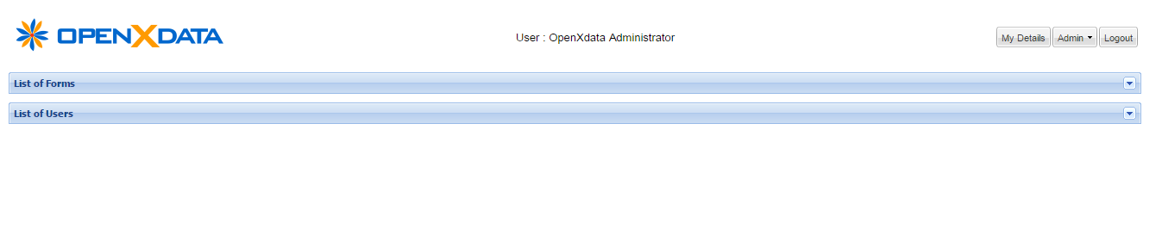
Basic Functionality
It allows us to add new forms and perform various other operations with them.
Also we can see who all users are there in the system, what are their roles, their access privileges, we can modify the user related details also.

Slide 5
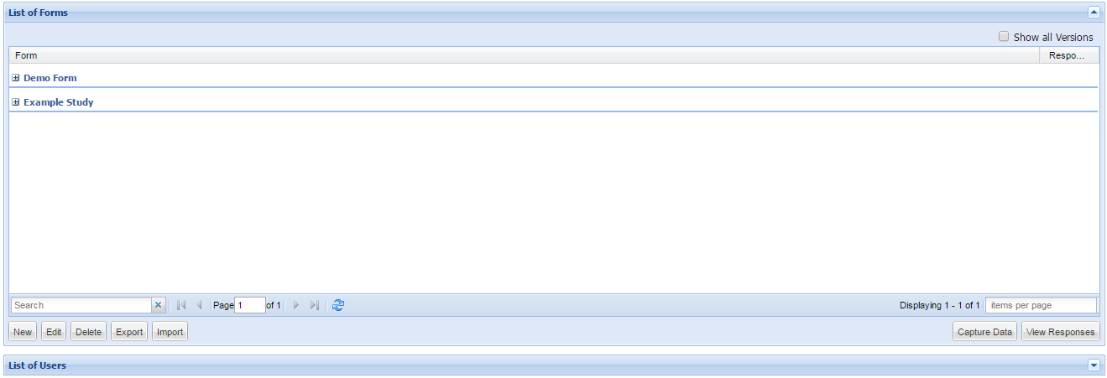
Forms
We can [add/ edit/ delete] new [Study/ Form]
We can [import /export] an existing [study/ form] [in/ to] the system also.

Slide 6
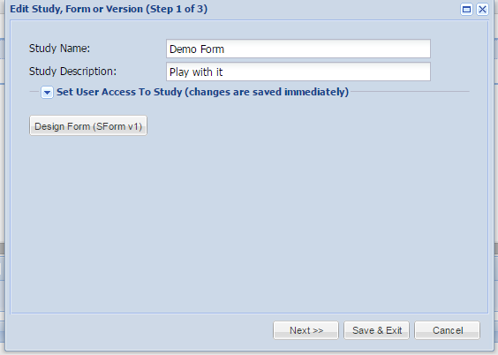
Design a Form
Click on the form which you want to design and select the edit option, then a dialog box will come, select Design Form option in it.

Slide 7
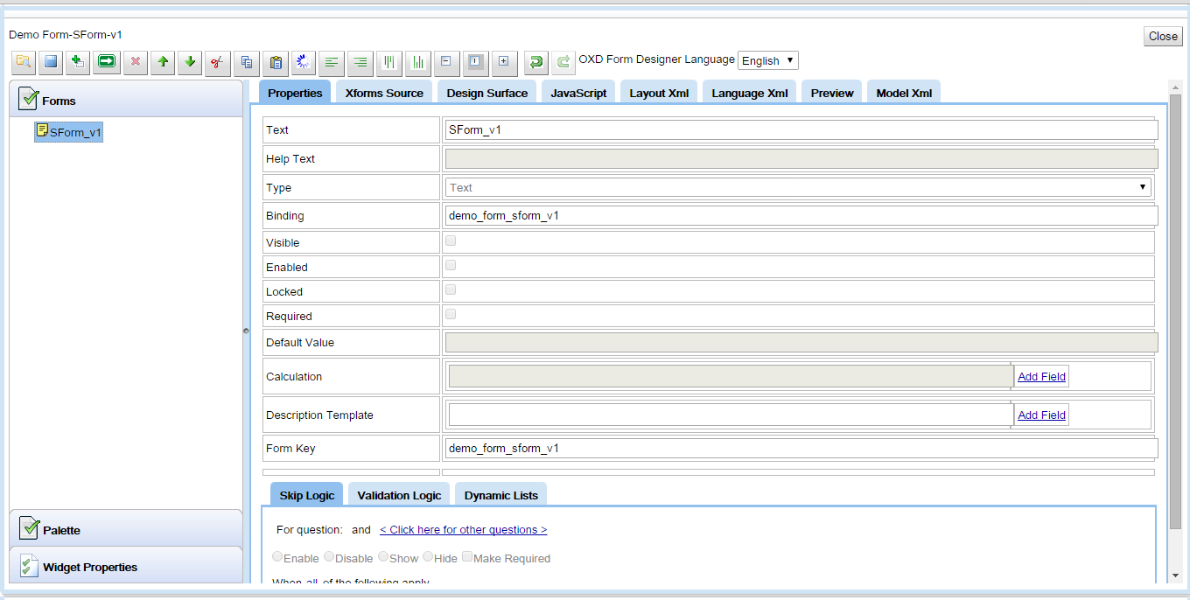
Parts of the Form Designer
I
II
III

Slide 8
I. Top Section (Toolbar)
Open / Import
Save
Add New – adds something at the same level as what you have already highlighted
Add New Child – adds something one level below what you have highlighted if possible. If not possible, produces the same functionality as using Add New
Delete – deletes a page, question, option, or widget
Move Up – move a question, page or option Up
Move Down
Cut a question
Copy a question
Paste a question
Reloads the form from the server (Refresh)
Align Left – used for aligning widgets in Design Surface
Align Right
Align Top
Align Bottom
Make Same Width – used for making widgets the same width in Design Surface
Make Same Height
Make Same Size – make both height and width the same in the Design Surface
Undo – used in Design Surface only
Redo – used in Design Surface only

Slide 9
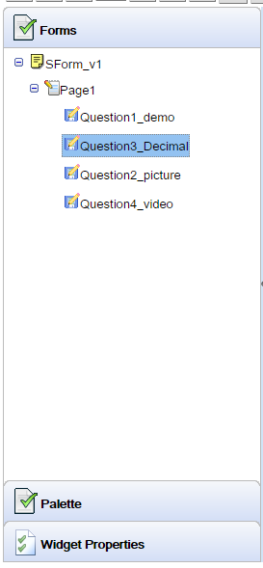
II. Left Section (Forms, Palette, Widget Properties )
Forms:
Here you can add pages and questions under them. They can be moved up and down, copy and paste them in this window
Palette:
Brings up a new left window used for editing your web form
Widget Properties :
Edit properties of elements in your web form

Slide 10
III. Middle Section
Properties tab:
All the question properties are edited here
XForms Source:
Lets you view and edit the raw xform
Design Surface:
This is where you create a web form
Javascript:
Add extra functionality to your web form
Layout XML:
The XML for your web form layout
Preview:
Preview your web form and its functionality. Use to check skip logic and all.
ModelXML:
If you press Submit in the Preview tab while testing your form, the ModelXML tab will open and display the xform data as it will end up on the server.

Slide 11
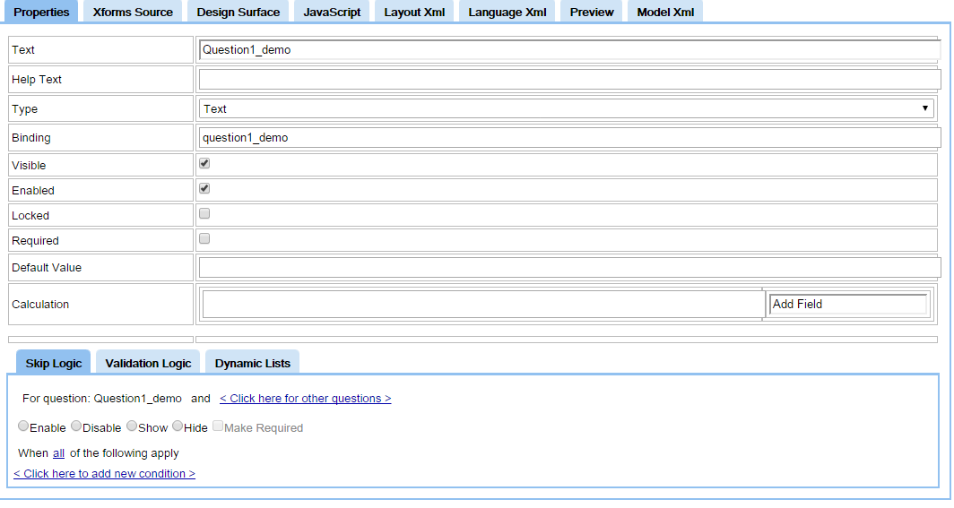
Property Tab
Property Tab 1
Property Tab 2

Slide 12
Property Tab 1
Properties tab allows you to define the following:
Text :
This is what appears in the list of questions on the mobile client and is what the Design Surface will default as the question label.
Help Text :
This will scroll along the top of the mobile phone screen when the user is in the question or will be the default tooltip for the question when the user is in web capture
Type :
Lets you change the question type, the options are (Text, Number, Decimal, Date, Time, DateTime, Boolean, Single Select, Multiple Select, Repeat, Picture, Video, Audio, Single Select Dynamic, GPS, Barcode) (note Barcode is non-functional in 1.16)
Binding :
The question binding is used as the column name in the form’s data table, it is also the xml tag identifier in the raw xml. The binding for an option in a single or multi select question becomes the value stored for that question in the xml.

Slide 13
Property Tab 1 (Cont.)
Visible :
If checked, the question is visible on the phone by default, and if not, it is not. The default setting is used by the Design Surface auto-layout to place questions on a page.
Enabled :
If a question is enabled, it is “active”.
Locked :
If a question is locked, a user cannot interact with it.
Required :
If a question is required, a form cannot be submitted without a value.
Default Value :
Automatically fills a value for the user such as a number, text, or a date/time.
Calculation :
The calculations field allows you to enter calculations using the questions bindings as a substitute for the value. Calculations only work on the mobile client at the moment. To run calculations on the web form use the JavaScript tab.
To help with the question bindings. click on Add Field and find questions these will then be added to the calculation field for you. You do not need = at the beginning of the row, like you do in excel. You can use mathematical operators like + * – to manipulate your values.

Slide 14
Property Tab 2
Skip Logic:
Skip Logic allows you to enable and disable questions based on a user’s answers to previous questions. On a paper form, it is usually done through instructions like “If Yes, go to question 4, if No go to Question 5″ With openXdata you can do this and more complicated skip logic using multiple question values and numerical values. In the sample form the Is Patient Pregnant question uses skip logic to become enabled only if the patient is Female.
Before you start adding skip logic:
Add all your questions,
Save your form and
Refresh the page
This ensures that all possible values are available to the logic builder.
Select how conditions will apply:
all – all the conditions must be met for the skip logic to occur
any – if any one of the following conditions occurs, the skip logic will happen
none – if none of the following conditions are true then the skip logic will happen
not all – if any of the following conditions does not occur, the skip logic will happen

Slide 15
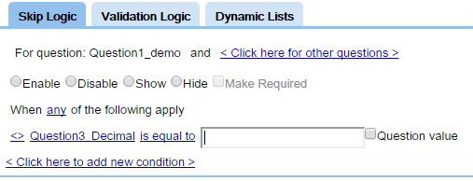
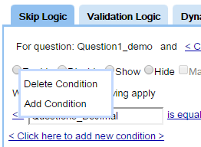
Property Tab 2 (Cont.)
Once you click < Click here to add new condition > a question will be automatically filled in for you.
When you click Question3 (or whatever your question Text is) it will open up a box where you can get the question you’re looking for. To find the question you want, delete the text that’s in the box and type the first few letters of the question you’re looking for , a drop down will appear with the possible questions in.
When you click is equal to you will get a dropdown that will give you different options depending on the question type.
Skip logic can’t evaluate certain question types like Picture, Audio, Video.
When you click ______ you will either be shown a list of options in the case of a Select box or a blank box with a checkbox Question value, as shown below.
Repeat this process until you have all your conditions. Then save your form.
Delete a condition: Click on <> to delete a condition

Slide 16
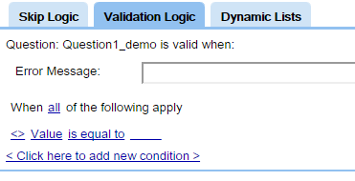
Property Tab 2 (Cont.)
Validation logic
Validation logic allows you to bring some initial data quality measures into your form by ensuring that your user enters appropriate data. Examples of validation logic include ensuring a date is not in the future, or that a numerical value is between two appropriate values. In the Sample Form, Birth Date, Weight, Height, and Details of Children questions all use validation logic.
The interface for validation logic is similar to that for Skip Logic.
Validation compares this questions Value or Length with another value. e.g. maybe you don’t want a name longer than 10 characters – use a text question and validate with Length -> is than or equal to ->10
Note that the conditions that you enter are the conditions that describe a valid value, and the error message is the message that appears when a user has done something wrong and the conditions are not met.

Slide 17
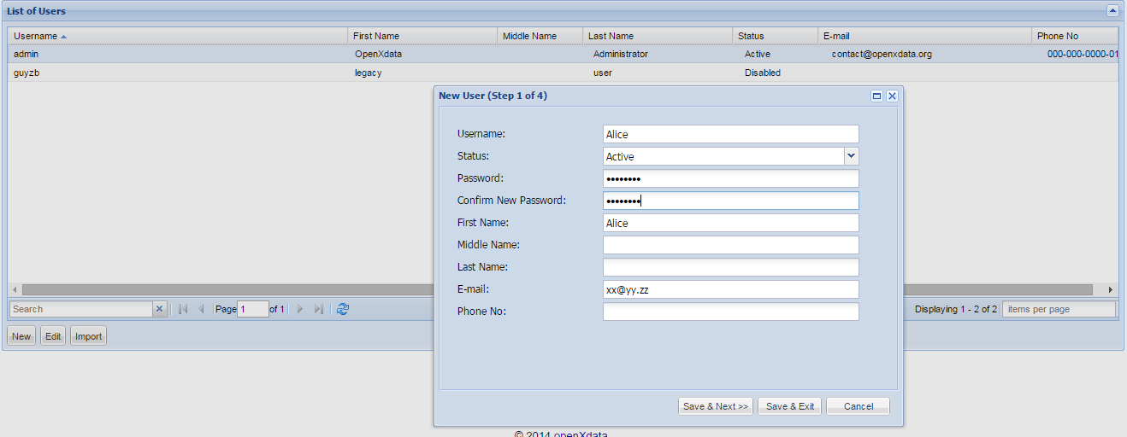
Users
We can [add/ edit/ import] Users

Slide 18
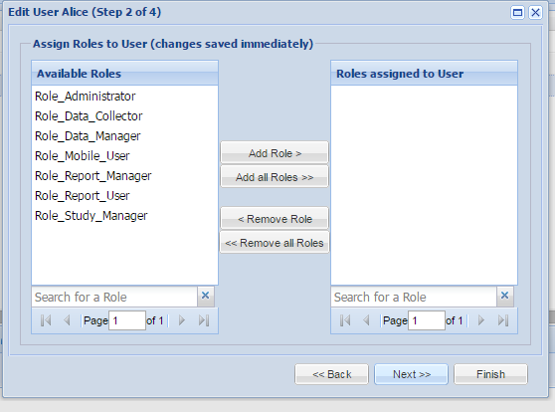
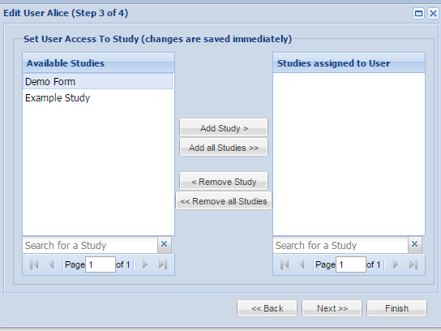
Can assign roles to each user
Set access to study/ form to user

